Slide 1

DATA 612 Project 1 | Global Baseline Predictors and RMSE
Jun Pan
June 9, 2019

Slide 2
Briefly describe the recommender system that you’re going to build out from a business perspective
I built a simple recommender system for Data Science Books. This system will take readers input ratings for their familiar data science books and predict the reader's preference for possible unreaded books. This is similar in approach to systems used by Netflix, Hulu and Amazon Prime.

Slide 3
Build out my own toy dataset
I have collected data on 5 popular data science books:
Machine Learning (Tom Mitchell),
The Master of Algorithm (Pedro Domingos),
R Cookbook (Paul Teetor),
Artificial Intelligence: A Modern Approach(Stuart Russell and Peter Norvig),
Natrual laguage Processing with Python (Steven Bird, Ewan Klein and Edward Loper) .
Friends were asked to rate these shows from 1 for 'Awful' to 5 for 'Outstanding' and to leave blank un-read.
The data were used to generate a basic recommendation system for a test set of withheld data and unread books.

Slide 4
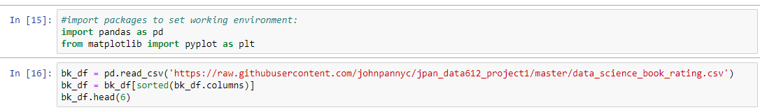
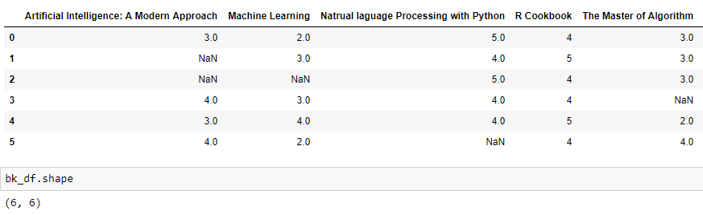
Load Data Create User-Item Matrix

Slide 5
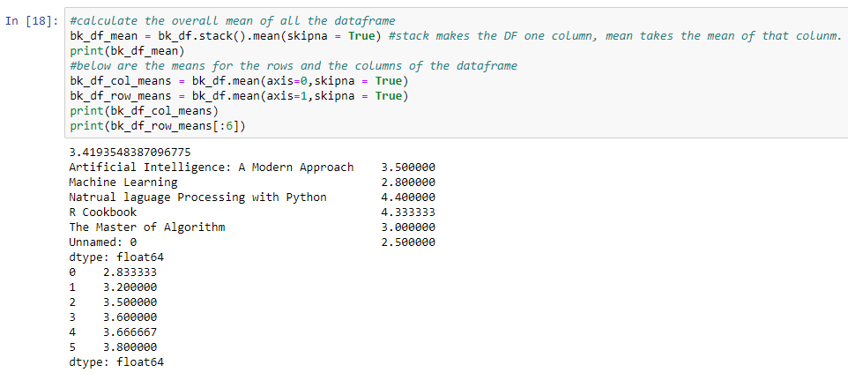
Overall Mean of Dataset

Slide 6
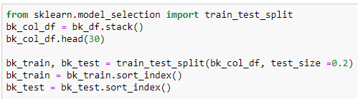
Break my ratings into separate training and test datasets.

Slide 7
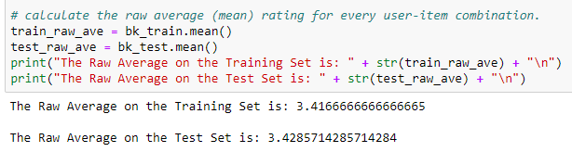
Raw Average of Train and Test Datasets

Slide 8
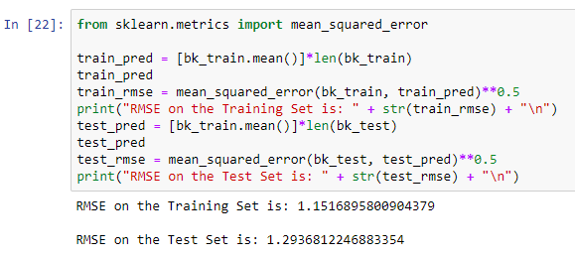
Calculate the RMSE for raw average for both my training data and your test data.

Slide 9
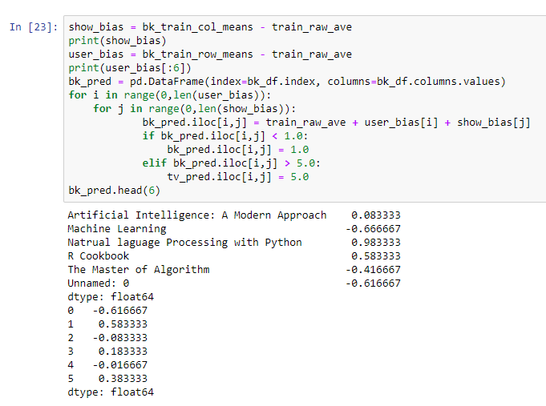
Using my training data, calculate the bias for each user and each item.

Slide 10
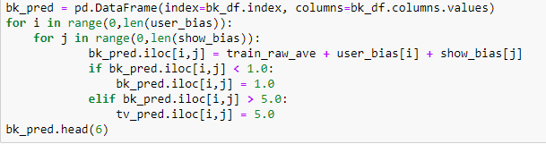
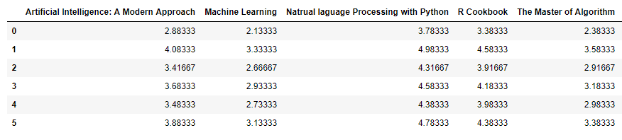
From the raw average, and the appropriate user and item biases, calculate the baseline predictors for every user-item combination.

Slide 11

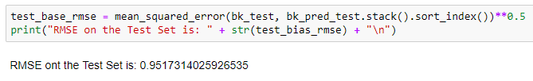
Calculate the RMSE for the baseline predictors for both your training data and your test data.

Slide 12
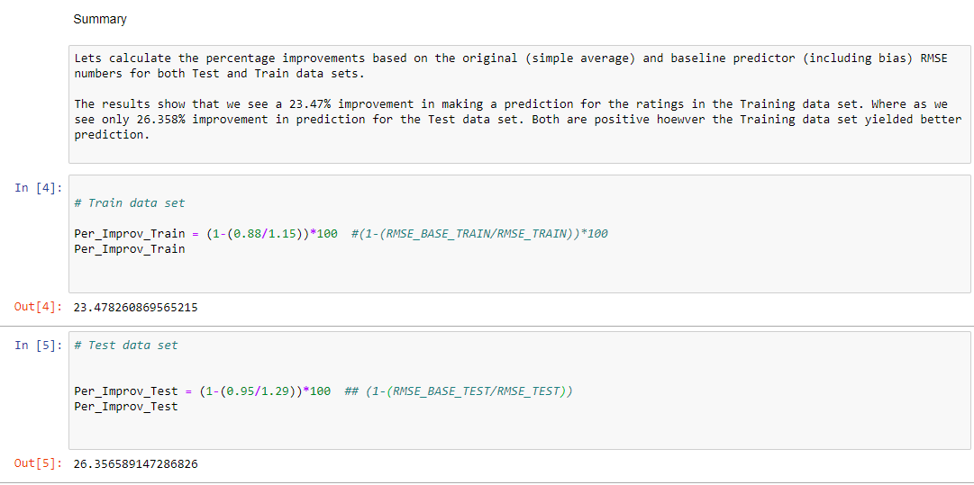
Summary

